Slide 1

Generative AI: GANs and Diffusion

Slide 2
Generative Models (Overview)
GAN: Adversarial
training
Diffusion Models:
Gradually add Gaussian
Noise and then reverse
VAE: Maximize
variational lower bound
Flow-Based Models:
Invertible transform of
distributions
https://lilianweng.github.io/posts/2021-07-11-diffusion-models/
Notes:
As the name suggests, generative AI models are used to create art and text. Broadly speaking, generative models can be classified into four groups – Generative Adversarial Networks, Diffusion Models, Variational Auto-Encoders (VAEs), and Flow models.
As we learned in our last session, a GAN pairs a generator with a discriminator. The generator samples a latent space (z) and outputs a new set of datapoints, labelled x prime. The discriminator, on the other hand, is trained on real examples (x) and then predicts whether a given example from the generator (x prime) is fake or real (zero or one).
Diffusion models begin with a valid example and slowly add noise (steps x0, x1, x2, etc…) until a randomized latent space is created. The process is then reversed (dashed line) until a new example (x0) has been generated.
We will not talk about variational autoencoders or flow models in this presentation.
=====
The x variable represents a real data sample, x’ is fake data, and z is a latent variable.
Diffusion Models work by destroying training data through the successive addition of Gaussian noise, and then learning to recover the data by reversing this noising process.
(https://developer.nvidia.com/blog/improving-diffusion-models-as-an-alternative-to-gans-part-1/)

Slide 3
Generative Models (Overview)
GAN: Adversarial
training
Diffusion Models:
Gradually add Gaussian
Noise and then reverse
VAE: Maximize
variational lower bound
Flow-Based Models:
Invertible transform of
distributions
https://lilianweng.github.io/posts/2021-07-11-diffusion-models/
Notes:
As the name suggests, generative AI models are used to create art and text. Broadly speaking, generative models can be classified into four groups – Generative Adversarial Networks, Diffusion Models, Variational Auto-Encoders (VAEs), and Flow models.
As we learned in our last session, a GAN pairs a generator with a discriminator. The generator samples a latent space (z) and outputs a new set of datapoints, labelled x prime. The discriminator, on the other hand, is trained on real examples (x) and then predicts whether a given example from the generator (x prime) is fake or real (zero or one).
Diffusion models begin with a valid example and slowly add noise (steps x0, x1, x2, etc…) until a randomized latent space is created. The process is then reversed (dashed line) until a new example (x0) has been generated.
We will not talk about variational autoencoders or flow models in this presentation.
=====
The x variable represents a real data sample, x’ is fake data, and z is a latent variable.
Diffusion Models work by destroying training data through the successive addition of Gaussian noise, and then learning to recover the data by reversing this noising process.
(https://developer.nvidia.com/blog/improving-diffusion-models-as-an-alternative-to-gans-part-1/)

Slide 4
Diffusion Models
Prafula Dhariwal & Alex Nichol. 2021, Diffusion Models Beat GANs on Image Synthesis.
Notes:
Recently, diffusion models have emerged as a powerful class of generative learning methods. When compared to GANs, diffusion models are learned with a fixed procedure and the latent variable has high dimensionality.

Slide 5
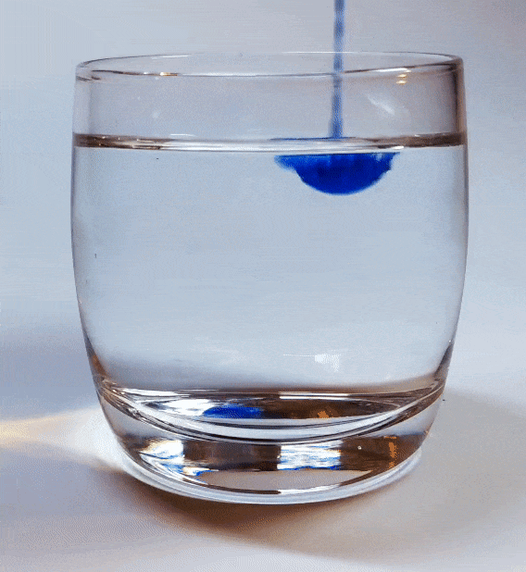
Notes:
First, diffusion models were inspired by non-equilibrium thermodynamics from physics.
According to the laws of physics, diffusion continues until it reaches an equilibrium. Now in the real world, the diffusion process cannot be reversed. But that is not the case in deep learning where our goal is to train a model to reverse this process. As diffusion progresses, information is lost. A trained deep neural network, however, can restore that information. The result is a clear image that looks like the original.

Slide 6
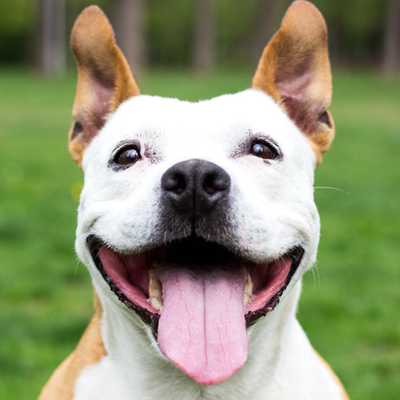
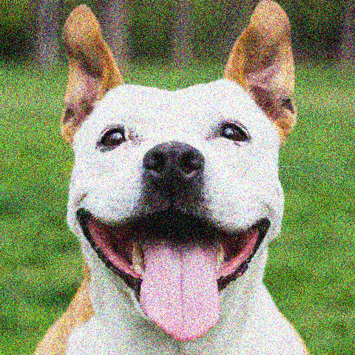
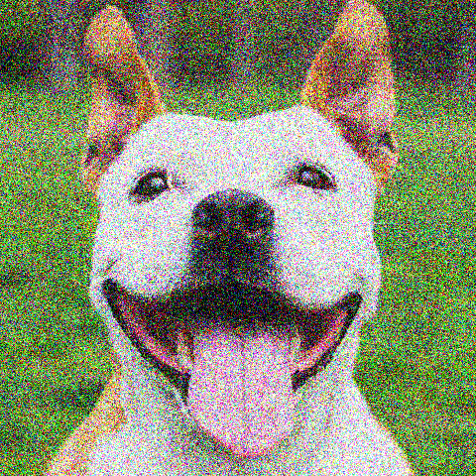
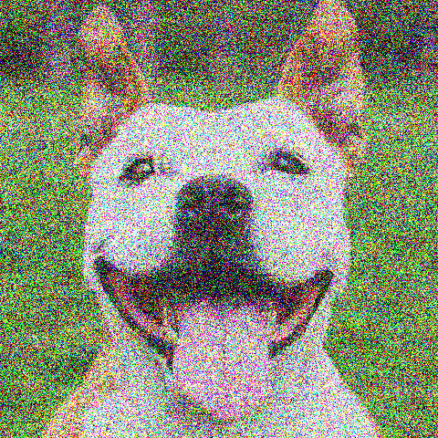
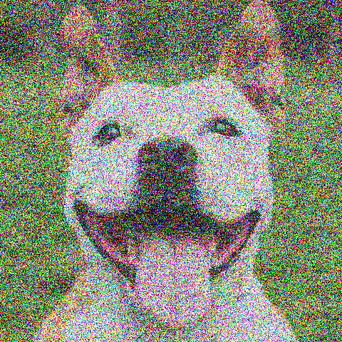
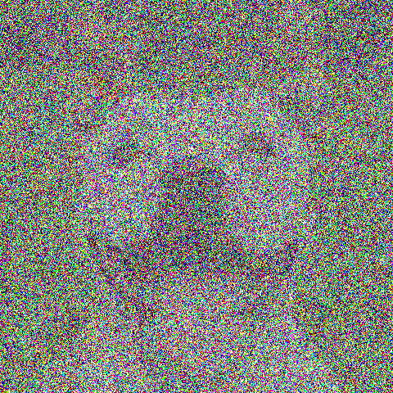
…
Markov Chain
…
Source: https://youtu.be/yTAMrHVG1ew
Notes:
Markov Chain – no cross dependencies – every step is only dependent on the steps immediately prior to it.
=====
Second, diffusion models work by replicating diffusion process by adding noise to original images and later learning how to reverse this noise process.
The noise is applied to the images following a Markov chain. What is a Markov chain? Markov Chain is a chain of events with the assumption that there are no cross dependencies and every step is only dependent on the steps immediately prior to it.

Slide 7
Forward diffusion process (fixed)
…
Data
Noise
…
Reverse denoising process (generative)
Source: https://youtu.be/yTAMrHVG1ew
Notes:
Diffusion models consist of two processes: forward diffusion and parametrized reverse.
A forward diffusion process maps data to noise by gradually perturbing the input data.
The second process is a parametrized reverse process that undoes the forward diffusion and performs iterative denoising.
=====
In conclusion, diffusion models consist of forwarding diffusion and parametrized reverse processes.
A forward diffusion process maps data to noise by gradually adding a little noise to our image until the image only consists of noise.
A parametrized reverse process that undoes the forward diffusion and performs iterative denoising to generate a new high-resolution images.

Slide 8
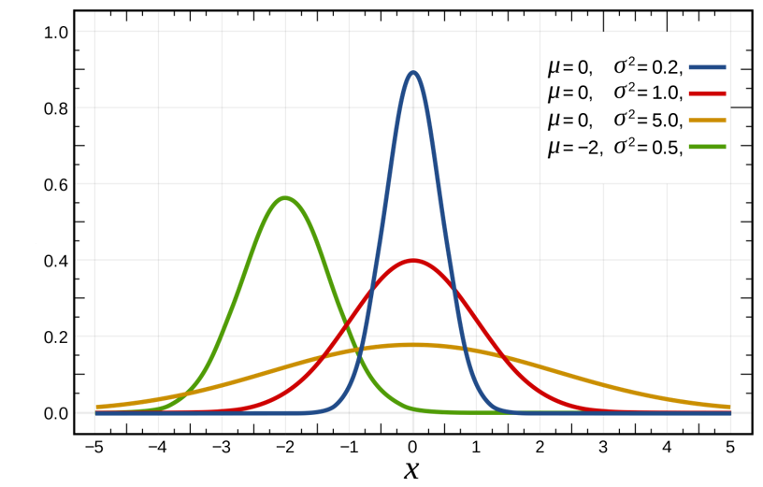
Source: https://youtu.be/yTAMrHVG1ew
Notes:
What does it mean to add noise to an image? There are many different types of noise. The noise that is added in the diffusion models is called the gaussian noise.
What is gaussian noise? Gaussian noise is a noise that has the probability distribution of a Gaussian (normal distribution) given the different mean and variation values. As the figure shows that the gaussian noise location and width of the distribution can change but the bell shape will stay the same.
Adding gaussian noise to an image means changing the values of the pixels of that image slightly and the area of the probability distribution.

Slide 9
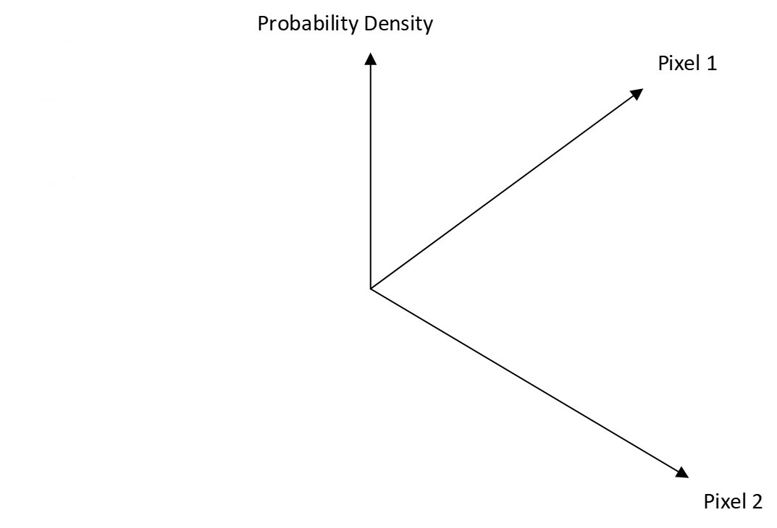
Source: https://youtu.be/yTAMrHVG1ew
Notes:
Let’s look at a simple example. Suppose we have a 2-pixel image. In the figure, the x-axis shows us the value of pixel 1, the y-axis shows us the value of pixel 2, and the z-axis gives us the probability distribution.
If our original image pixels are 120 and 90 out of zero to 255, we want to apply gaussian noise to this image.
First, we can draw the gaussian probability distribution where the mean is the original point and variance is determined by a constant (let's say it is 10).
Second, we select a random position inside this distribution. The random position could be anywhere really close to or far from the original point or somewhere in between (see the star points in the figure). The probability distribution tells us that the new point being closer to the original point is higher than it is further away from it.
In the end, after we randomly select the point, the image pixels in the next step of the Markov chain will be 115 and 80.
Remember that in reality normally images have many more pixels and when that happens we will have many more dimensions diffusion models add noise to the image until it becomes nothing but noise.

Slide 10
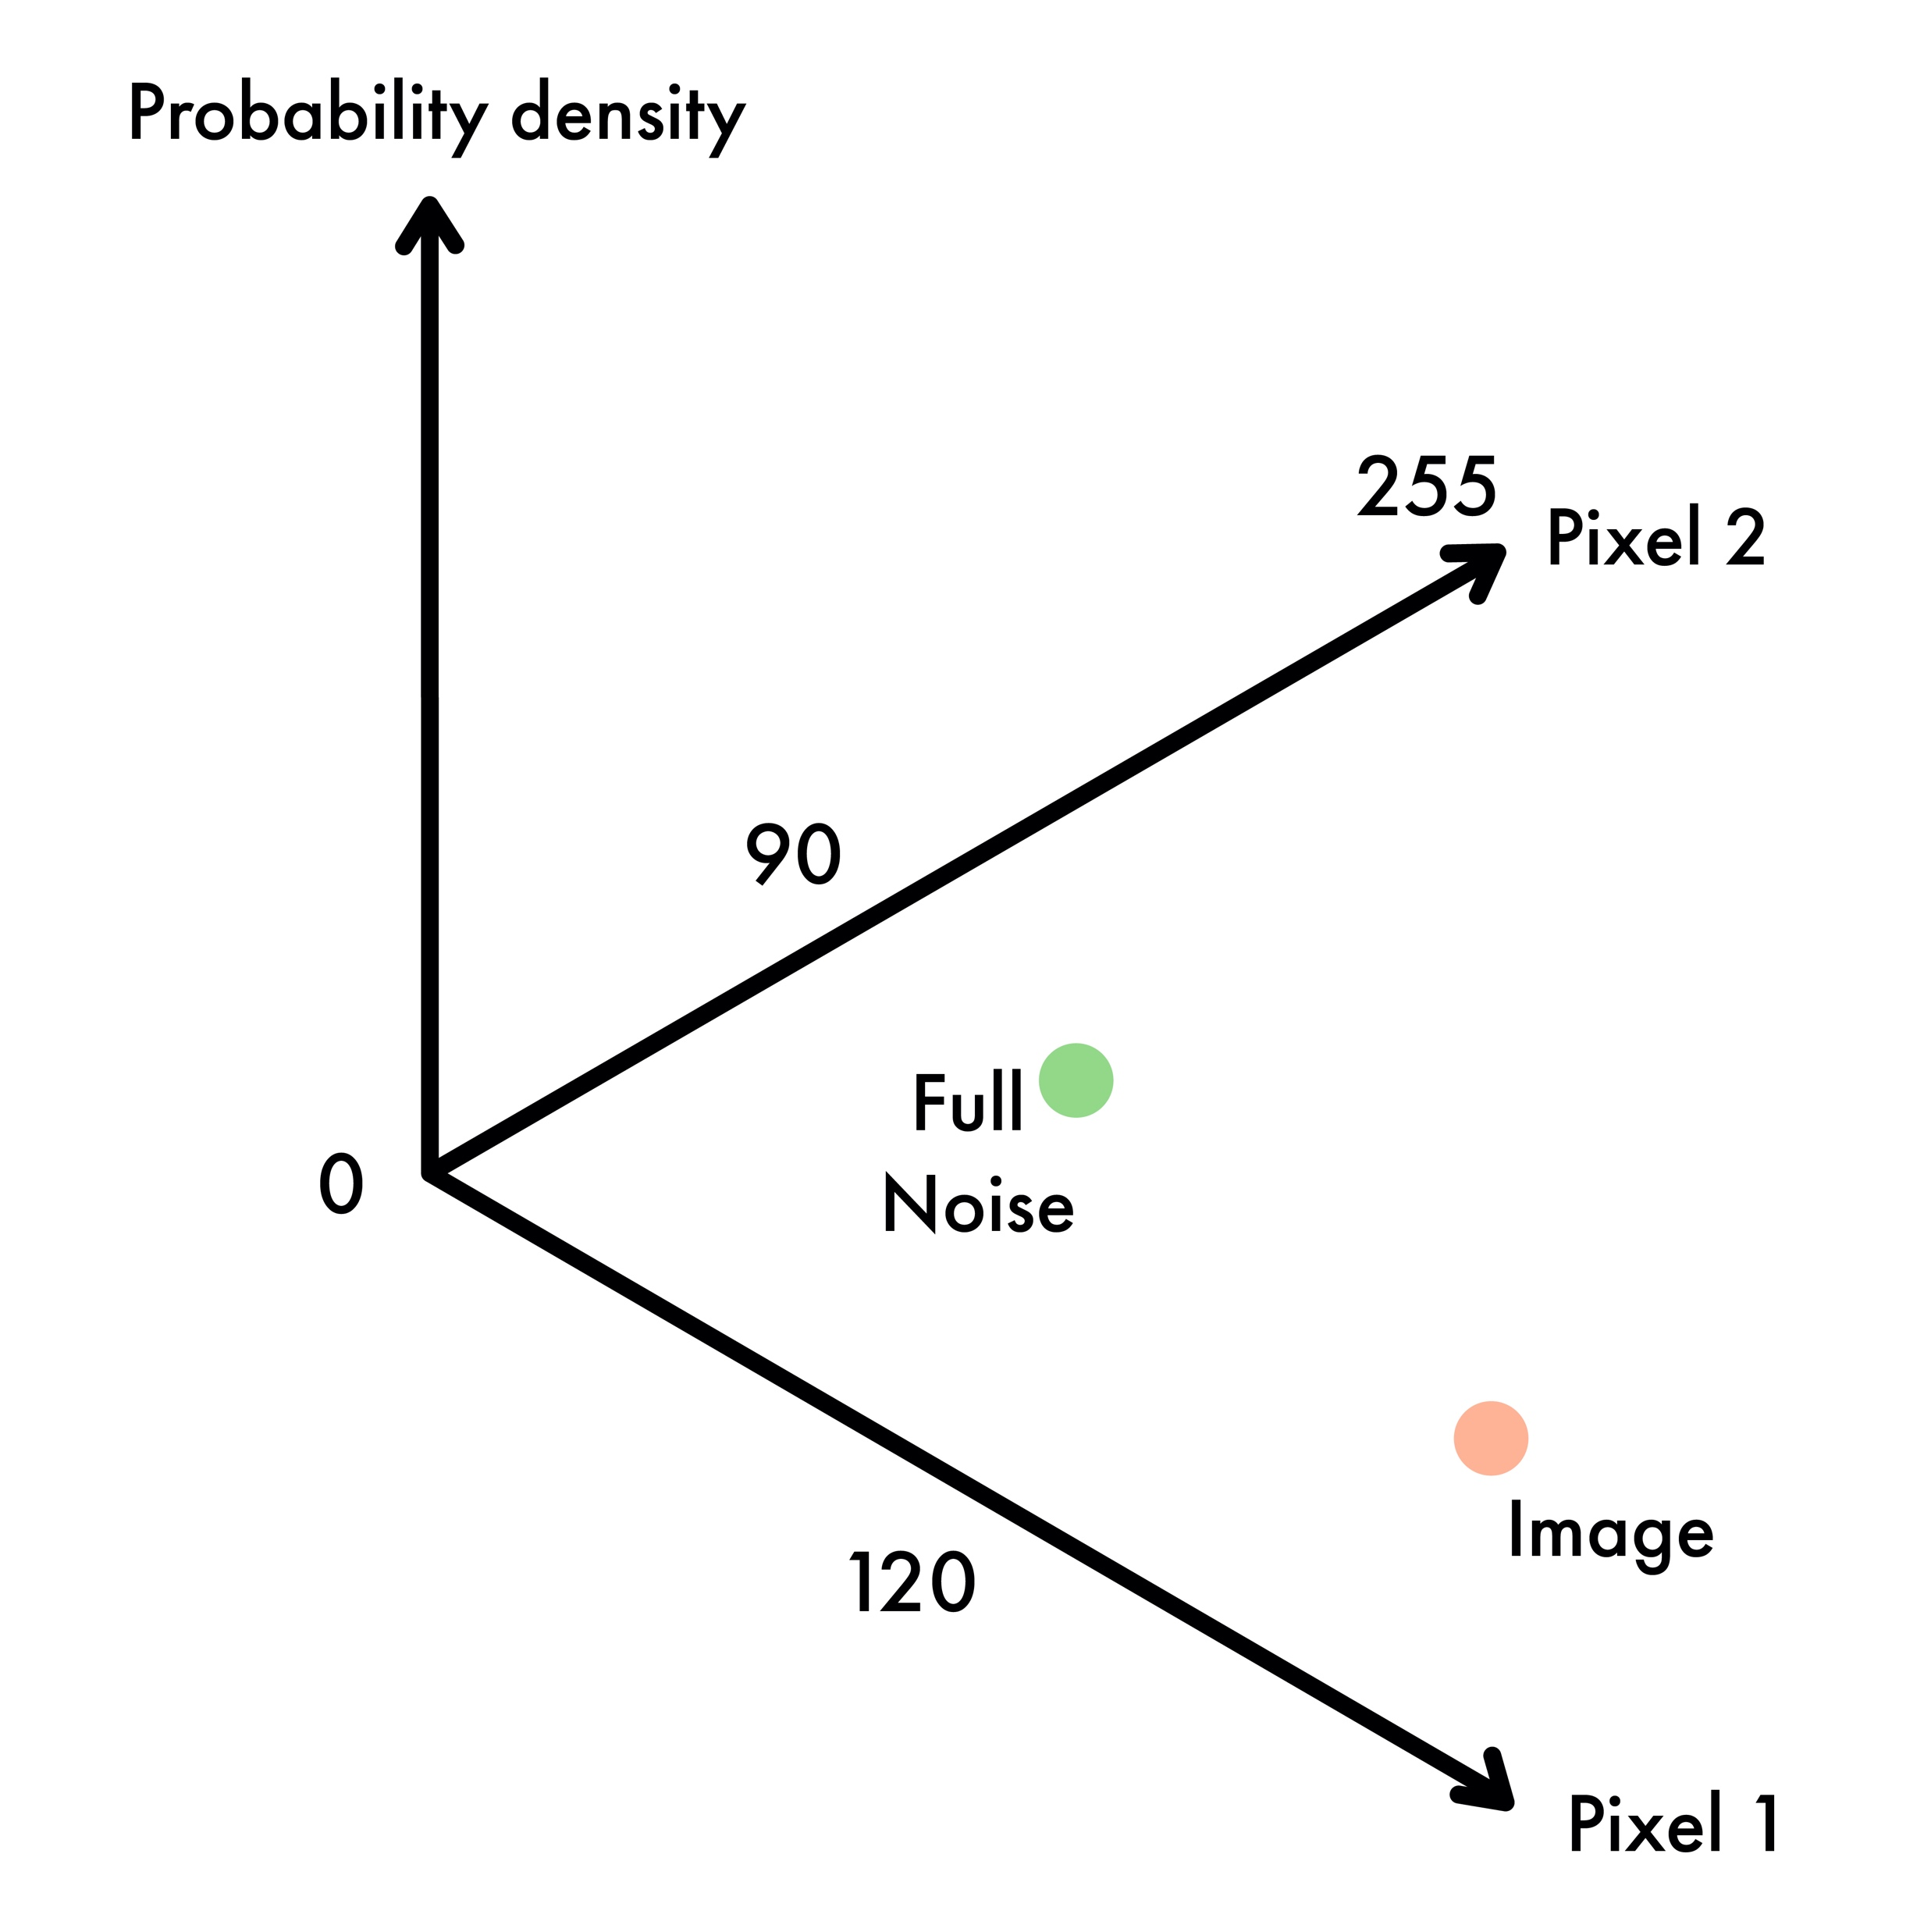

Source: https://youtu.be/yTAMrHVG1ew
Notes:
What does it mean to reverse or remove the noise? Revising or removing the noise means recovering the values of these pixels so that the resulting image will resemble the original image.
Let’s look at a two-pixel example.
In the left figure, the red point represents the original image, and the green point is full noise during the forward diffusion process. The image follows a path (green curve line) from the original position to the gaussian noise position.
During the reverse diffusion, we want to bring the gaussian noise position back to its original position as the right figure shows.

Slide 11
…
CNN
(Unet)
Source: https://youtu.be/yTAMrHVG1ew
Notes:
In diffusion models, to remove the noise and resemble the original image, we can input the image to a convolutional neural network and we ask the network to produce the previous step image.
The type of convolutional neural network is called a Unet.

Slide 12
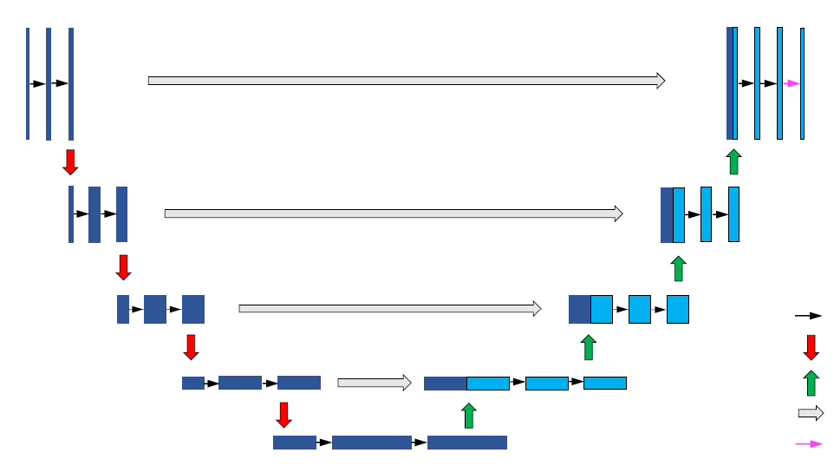
Unet
Conv, RELU
Max Pool
Trans Conv
Skip Connection
Conv(1x1)
Ronneberger et al., 2015, U-Net: Convolutional Networks for Biomedical Image Segmentation
Notes:
This is the Unet architecture. We call it Unet because of its shape. Through the convolutions, a small representation of the image is been made and then samples back to the original dimensions. In this way, it can be sure that the input and output dimensions have the same size.

Slide 13
High
Quality
Samples
Generative Adversarial
Networks
Denoising
Diffusion
Model
Mode
Coverage/
Diversity
Fast
Sampling
Variational Autoencoders,
Normalizing Flows
Xiao et al. 2022, Tacking the generative learning trilemma with denoising diffusion gans.
Notes:
Both GAN and diffusion model have shown great success in generating high-quality samples, but each has some limitations of its own. GAN models are known for potentially unstable training and less diversity in generation due to their adversarial training nature.
While diffusion models satisfy the high sample quality and diversity, they are slower than traditional GANs at generating samples time and computing due to using a long Markov chain for diffusion and denoising steps.
(https://lilianweng.github.io/posts/2021-07-11-diffusion-models/)
=====
Now we have a general understanding of both the GAN and diffusion model. From the previous studies, we know both GAN and diffusion models have shown great success in generating high-quality samples, but each has some limitations of its own.
GAN models are known for potentially unstable training and less diversity in generation due to their adversarial training nature.
While diffusion models satisfy the high sample quality and diversity, they are slower than traditional GANs at generating samples time and computing due to using a long Markov chain for diffusion and denoising steps
(https://lilianweng.github.io/posts/2021-07-11-diffusion-models/)
========
More resource:
Denoising Diffusion-based Generative Modeling: Foundations and Applications tutorial(https://cvpr2022-tutorial-diffusion-models.github.io/)
Computer Vision and Pattern Recognition (CVPR) conference (https://cvpr2022.thecvf.com/)

Slide 14
Applications
StyleGAN vs DALL-E

Slide 15
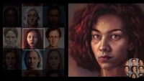
Notes:
StyleGAN2 intro video

Slide 16
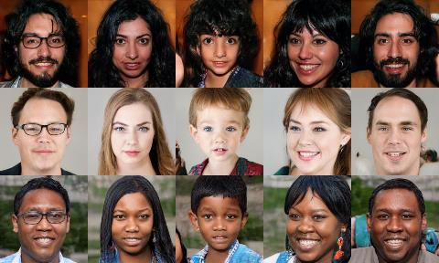
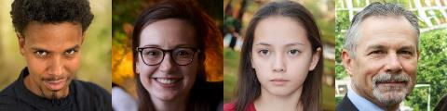
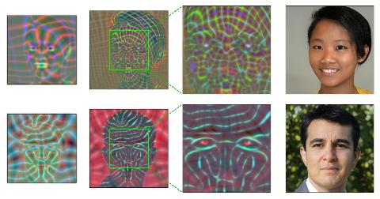
2018
StyleGAN
2020
StyleGAN2
2021
StyleGAN3
Notes:
Nvidia researchers introduced StyleGAN (a generative adversarial network) in December of 2018. They made the source code available in February of 2019.
StyleGAN utilizes Nvidia's CUDA software, GPUs, and Google's TensorFlow, or Meta AI's PyTorch, Pytorch became the official implementation library in later StyleGAN versions. Nvidia released StyleGAN 2 on February 5, 2020. This version improved image quality.
And finally, Nvidia released StyleGAN3 on October 12, 2021.

Slide 17
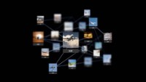
Notes:
DALL-E 2 intro video
DALL-E and DALL-E 2 are machine learning models developed by OpenAI to generate digital images from natural language descriptions.

Slide 18
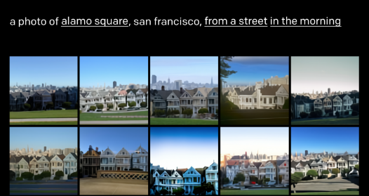
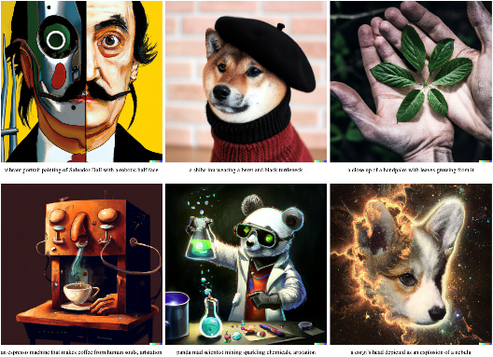
2021
DALL-E
2022
DALL-E 2
Notes:
OpenAI released DALL-E in a blog post in January 2021. It used a modified version of GPT-3 to generate images.
In April of 2022, OpenAI announced DALL-E 2. This release is designed to generate realistic images at higher resolutions . DALL-E 2 can combine concepts, attributes, and styles. OpenAI has not released source code for either model, although output from a limited selection of sample prompts is available at their website.

Slide 19
Case Study: Hanfu Dresses
StyleGAN3 vs DALL-E 2

Slide 20
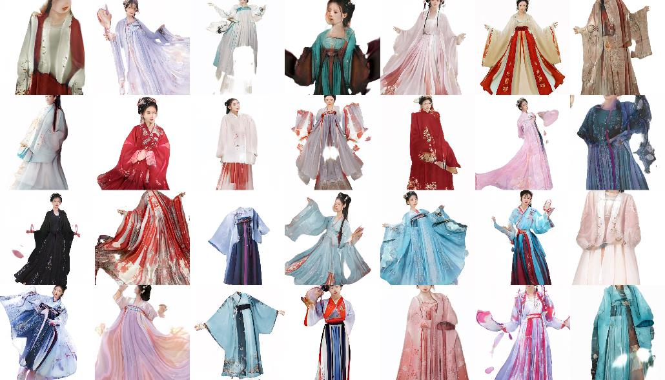
StyleGAN3: Generated hanfu dress Images
Notes:
Hanfu dress videos links:
https://youtu.be/hs09ibfKPfQ
https://youtu.be/mapHUN4oYOg

Slide 21
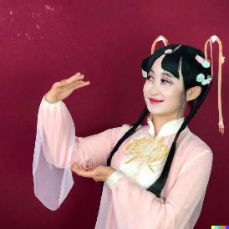
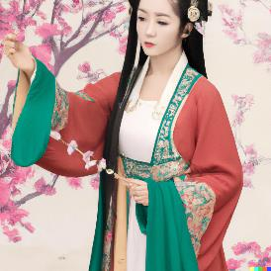
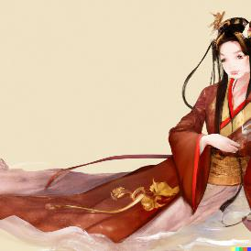
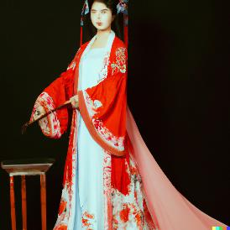
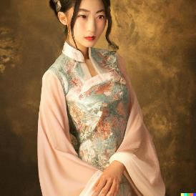
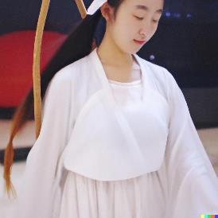
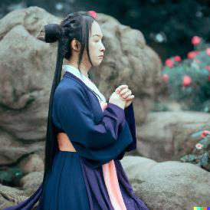
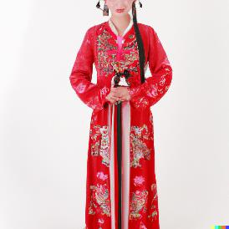
DALL-E 2: Huamulan in a hanfu dress.
DALL-E 2: A beautiful girl with a Hanfu dress.

Slide 23
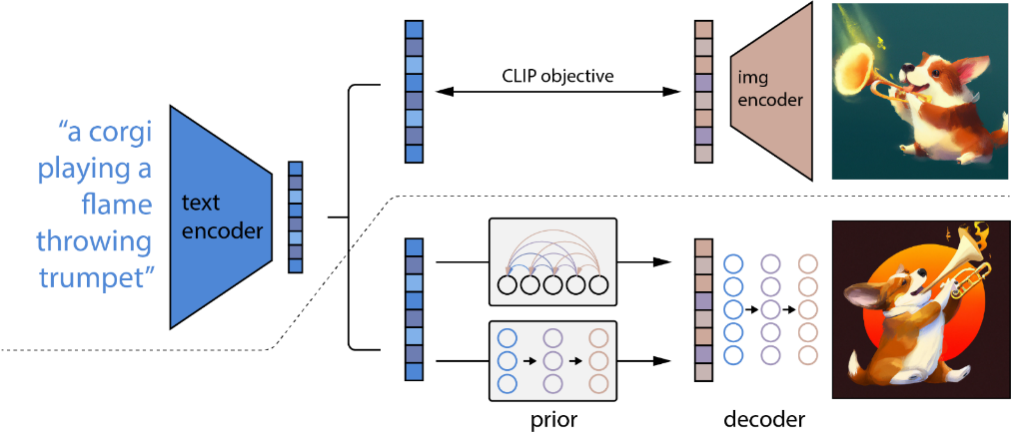
DALL·E 2
Model components
Aditya Ramesh et al. 2022, Hierarchical Text-Conditional Image Generation with CLIP Latents.
Notes:
DALL-E 2 hit the scene, setting a new bar for image generation and manipulation.
At the highest level, DALL-E 2's works very simply:
First, a text prompt is input into a text encoder that is trained to map the prompt to a representation space.
Then, a diffusion model prior maps from the CLIP text encoding to a corresponding CLIP image encoding.
Finally, an image decoder, the modified-GLIDE generation model maps from the representation space into the image space via reverse-Diffusion, generating one of many possible images that conveys the semantic information within the input caption.
(https://www.assemblyai.com/blog/how-dall-e-2-actually-works/)

Slide 24
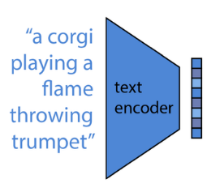
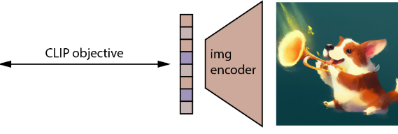
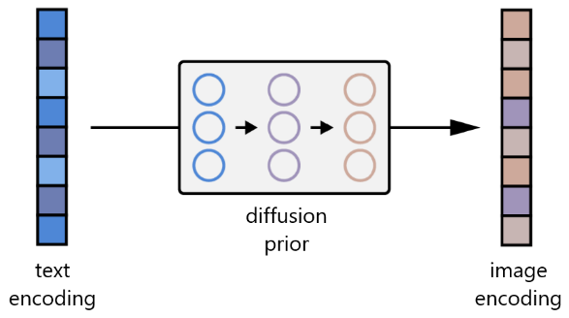
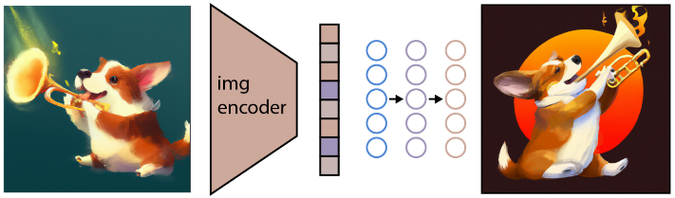
DALL·E 2
Model components
Step 1
Step 2
Step 3
Aditya Ramesh et al. 2022, Hierarchical Text-Conditional Image Generation with CLIP Latents.
Notes:
Now, let us dive into each of the above steps separately.
Step 1 - Linking Textual and Visual Semantics
How does DALL-E 2 know the way a textual is manifested in the visual space?
The link between textual semantics and their visual representations in DALL-E 2 is learned by a model called CLIP (Contrastive Language-Image Pre-training).
CLIP is trained on hundreds of millions of images and their associated texts, learning how much a given text snippet relates to an image. That is, rather than trying to predict a text given an image, CLIP instead just learns how related any given text is to an image.
Step 2 - Mapping from Textual Semantics to Corresponding Visual Semantics
How does DALL-E 2 go about injecting the text conditioning information from our prompt into the image generation process?
DALL-E 2 uses another model, call the prior (a diffusion model), to map from the text encodings of image captions to the image encodings of their corresponding images.
The Diffusion Prior in DALL-E 2 consists of a decoder-only Transformer. It operates, with a causal attention mask, on an ordered sequence of (i) The tokenized text. (ii) The CLIP text encodings of these tokens. (iii) An encoding for the diffusion timestep. (iv) The noised image passed through the CLIP image encoder. (v) Final encoding whose output from Transformer is used to predict the un-noised CLIP image encoding.
Step 3 - Generating Images from Visual Semantics
How does DALL-E 2 learn to reverse the image encoding mapping to accomplish image generation?
DALL-E 2 employs a modified version models GLIDE to perform image generation. As depicted in the image above, a Corgi playing a flamethrowing trumpet passed through CLIP's image encoder. GLIDE then uses this encoding to generate a new image that maintains the salient features of the original.
It should be noted that the goal is not to build an autoencoder and exactly reconstruct an image given its embedding, but to instead generate an image which maintains the salient features of the original image given its embedding.
GLIDE extends the core concept of Diffusion Models by augmenting the training process with additional textual information, ultimately resulting in text-conditional image generation
(https://www.assemblyai.com/blog/how-dall-e-2-actually-works/)

Slide 25
Jonathan Ho et al. “Denoising diffusion probabilistic models.” arxiv Preprint arxiv:2006.11239 (2020). [code]
Alex Nichol & Prafulla Dhariwal. “Improved denoising diffusion probabilistic models” arxiv Preprint arxiv:2102.09672 (2021). [code]
[Prafula Dhariwal & Alex Nichol. “Diffusion Models Beat GANs on Image Synthesis." arxiv Preprint arxiv:2105.05233 (2021). [code]
Xiao et al. “Tackling the Generative Learning Trilemma with Denoising Diffusion GANs.” arXiv:2112.07804 (2021) [code]
Aditya Ramesh et al. “Zero-Shot Text-to-Image Generation.” arXiv:2102.12092 (2021).
Aditya Ramesh et al. “Hierarchical Text-Conditional Image Generation with CLIP Latents." arxiv Preprint arxiv:2204.06125 (2022).

